Slide 1

Machine Learning Unit-I
Mrs. B. Ujwala, Asst. Professor

Slide 2
What is Learning?
“The process of gaining knowledge and expertise.” From The Adult Learner by Malcolm Knowles
“A process that leads to change, which occurs as a result of experience and increases the potential of improved performance and future learning.” From How Learning Works: Seven Research-Based Principles for Smart Teaching by Susan Ambrose, et al.

Slide 3
What is Machine Learning?
Informal Definition: Arthur Samuel, Scientist, StanfordLab
Machine Learning is the field of study that gives computers the ability to learn without being explicitly programmed.
Formal Definition : Tom Mitchell, Professor of ML Dept, Carnegie Mellon University
A computer program is said to learn from experience (E) with respect to some class of task (T) and some performance measure (P), if its performance at tasks in T, as measured by P, improves with experience E.

Slide 4
What is Machine Learning? Cont…
In general, to have a well-defined learning problem, we must identify the following:
Class of task
Performance measurement that needs to be improved
Source of experience
Example: Robot navigation in a maze
Class of task: Reaching the end of the maze
Performance measurement: Time taken to reach the end of the maze
Source of experience: Navigating the maze from start to finish by the robot

Slide 5
Evolution of Machine Learning
1950 – Alan Turing proposes “Learning Machine”
1952 – Arthur Samuel developed first Machine Learning program that cloud play Checkers
1957 – Frank Rosenblatt designed the first neural network program
1967 – Nearest Neighbor algorithm created
1979 – Stanford University students develop first self-driving cart that can navigate and avoid obstacles in a room
1982 – Recurrent Neural Network developed
1989 – Reinforcement Learning Conceptualized; Beginning of commercialization of ML

Slide 6
Evolution of Machine Learning cont…
1995 – Random Forest and Support Vector Machine algorithms developed
1997 – IBM’s Deep Blue beats the world chess champion Gary Kasparov
2006 – First Machine Learning competition launched by Netflix; Geoffrey Hinton conceptualizes Deep Learning
2010 – Kaggle, a website for Machine Learning competition, launched
2011– IBM’s Watson beats two human champions in jeopardy
2016 – Google’s AlphaGo Program beats professional human player

Slide 7
Why do we use Machine Learning?
ML is used when:
Human expertise does not exist (navigating on Mars),
Humans are unable to explain their expertise (speech recognition)
Solution changes in time (routing on a computer network)

Slide 8

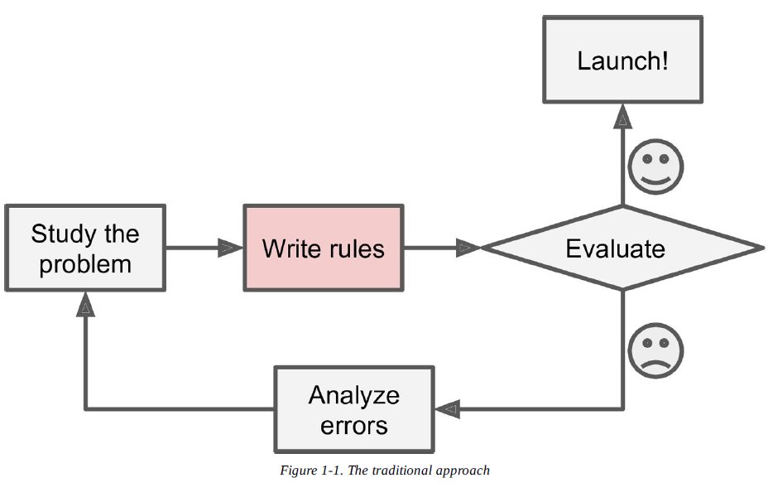
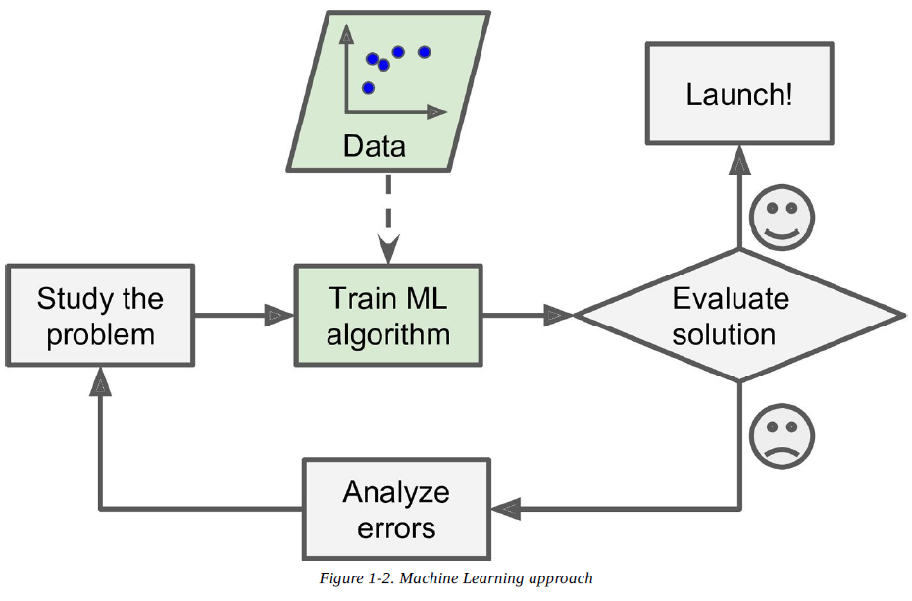

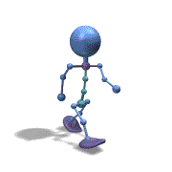
Traditional/ML
Traditional
Machine Learning

Slide 9
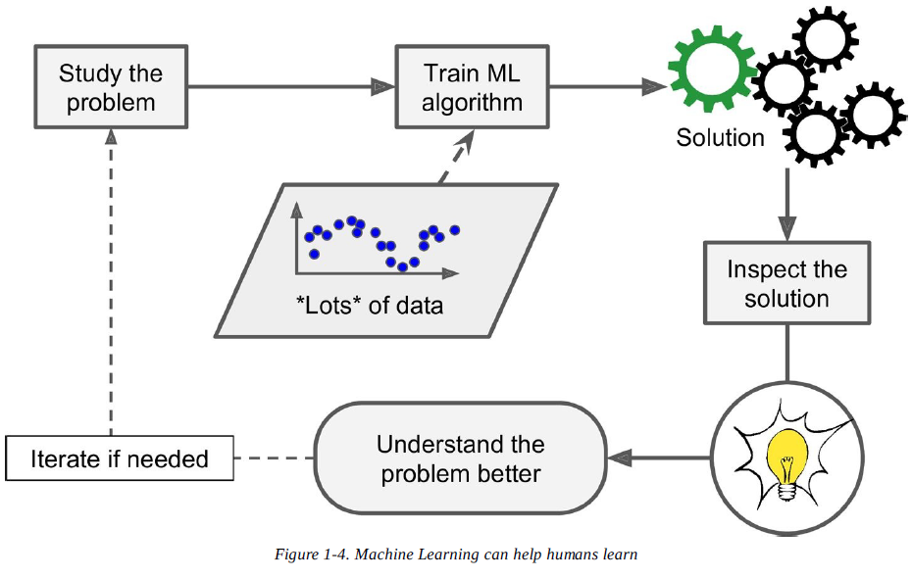
Machine Learning Flow

Slide 10
Types of Machine Learning
Machine learning can be classified into 3 types of algorithms.
Supervised Learning
Unsupervised Learning
Reinforcement

Slide 11
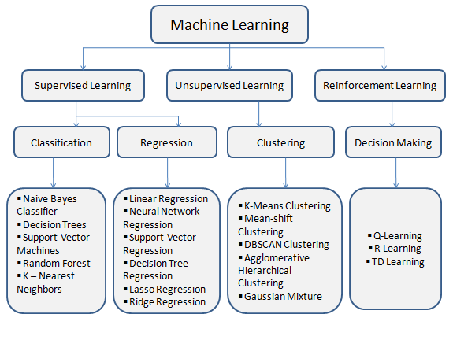
Types of Machine Learning

Slide 12
Supervised learning
In Supervised learning, the system is presented with data which is labeled, and based on the training, the machine predicts the output.
The main goal of the supervised learning technique is to map the input variable(x) with the output variable(y).
Some real-world applications of supervised learning are weather prediction, sales forecasting, stock price analysis, Spam filtering, etc.

Slide 13
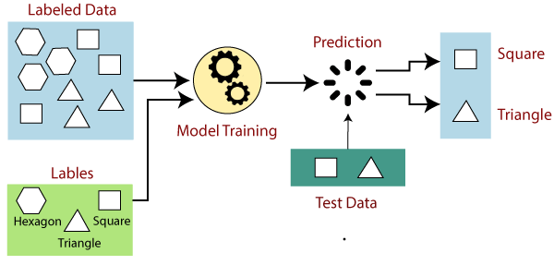

Slide 14
Advantages:
With the help of supervised learning, the model can predict the output on the basis of prior experiences.
In supervised learning, we can have an exact idea about the classes of objects.
Disadvantages:
Supervised learning models are not suitable for handling the complex tasks.
Supervised learning cannot predict the correct output if the test data is different from the training dataset.
Training required lots of computation times.
In supervised learning, we need enough knowledge about the classes of object.

Slide 15
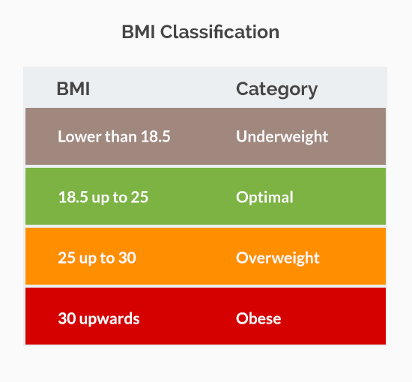
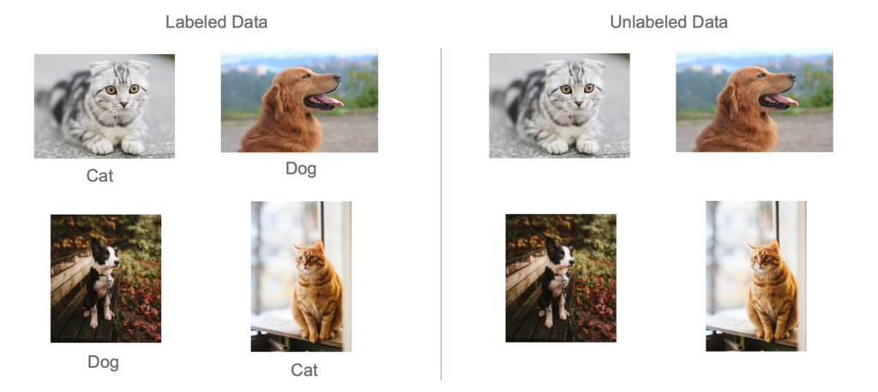
Labeled Data

Slide 16
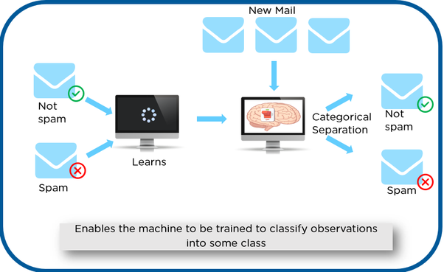
Supervised learning Cont…
Example of Supervised Learning

Slide 17
Types of Supervised learning
Classification: Supervised learning problem that involves predicting a class label.
Regression: Supervised learning problem that involves predicting a numerical value.

Slide 18
Types of Supervised learning
Classification is a type of supervised learning where a target variable is of categorical, is predicted for test data based on the information imparted by training data.
Regression is a type of supervised learning where a target variable is continuous value / real value.

Slide 19
Unsupervised Learning
In unsupervised machine learning, the machine is trained using the unlabeled dataset, and the machine predicts the output without any supervision.
The main objective is to take dataset as input and try to find patterns within the data.
Is also called as Pattern discovery / Knowledge discovery

Slide 20
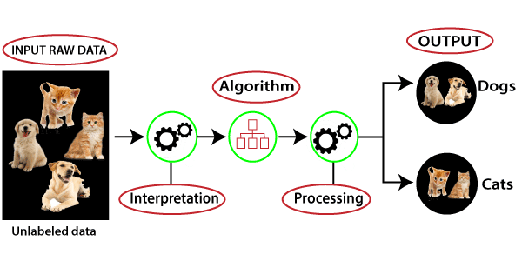

Slide 21
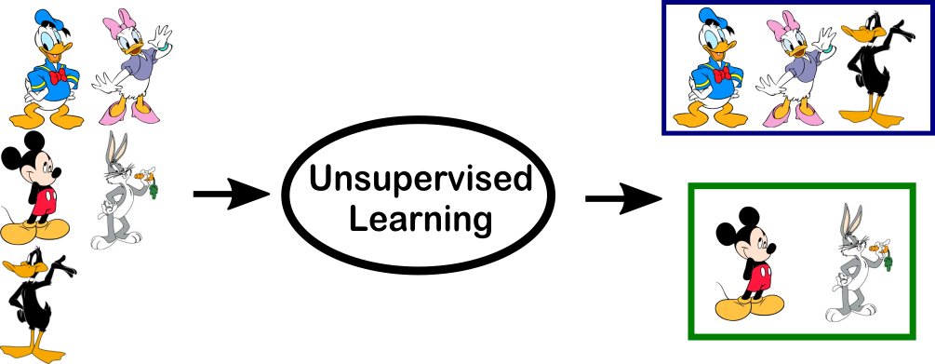
Unsupervised Learning
Example of Unsupervised Learning

Slide 22
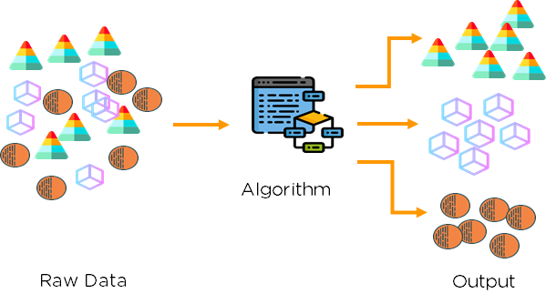
Unsupervised Learning
Example of Unsupervised Learning

Slide 23
Types of Unsupervised learning
Clustering:
Clustering is a method of grouping the objects into clusters such that objects with most similarities remains into a group and has less or no similarities with the objects of another group.
Cluster analysis finds the commonalities between the data objects and categorizes them as per the presence and absence of those commonalities.

Slide 24
Types of Unsupervised learning
The clustering technique can be widely used in various tasks. Some most common uses of this technique are:
Social network analysis
Image segmentation
Anomaly detection, etc.

Slide 25
Types of Unsupervised learning
Association:
An association rule is an unsupervised learning method which is used for finding the relationships between variables in the large database.
It determines the set of items that occurs together in the dataset.
Association rule makes marketing strategy more effective. Such as people who buy X item (suppose a bread) are also tend to purchase Y (Butter/Jam) item. A typical example of Association rule is Market Basket Analysis

Slide 26
Advantages of Unsupervised Learning
Unsupervised learning is used for more complex tasks as compared to supervised learning because, in unsupervised learning, we don't have labeled input data.
Unsupervised learning is preferable as it is easy to get unlabeled data in comparison to labeled data.
Disadvantages of Unsupervised Learning
Unsupervised learning is intrinsically more difficult than supervised learning as it does not have corresponding output.
The result of the unsupervised learning algorithm might be less accurate as input data is not labeled, and algorithms do not know the exact output in advance.

Slide 27
Reinforcement Learning
Reinforcement learning describes a class of problems where an agent operates in an environment and must learn to operate using feedback.
Reinforcement learning follows trial and error method to get the desired result.

Slide 28
Reinforcement Learning
Reinforcement learning problems are reward-based. For every task or for every step completed, there will be a reward received by the agent. If the task is not achieved correctly, there will be some penalty added.
An example of a reinforcement problem is playing a game where the agent has the goal of getting a high score and can make moves in the game and received feedback in terms of punishments or rewards.

Slide 29
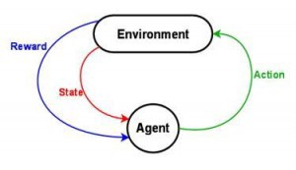
Reinforcement Learning
The agent observes the environment, takes an action to interact with the environment, and receives positive or negative reward.

Slide 30
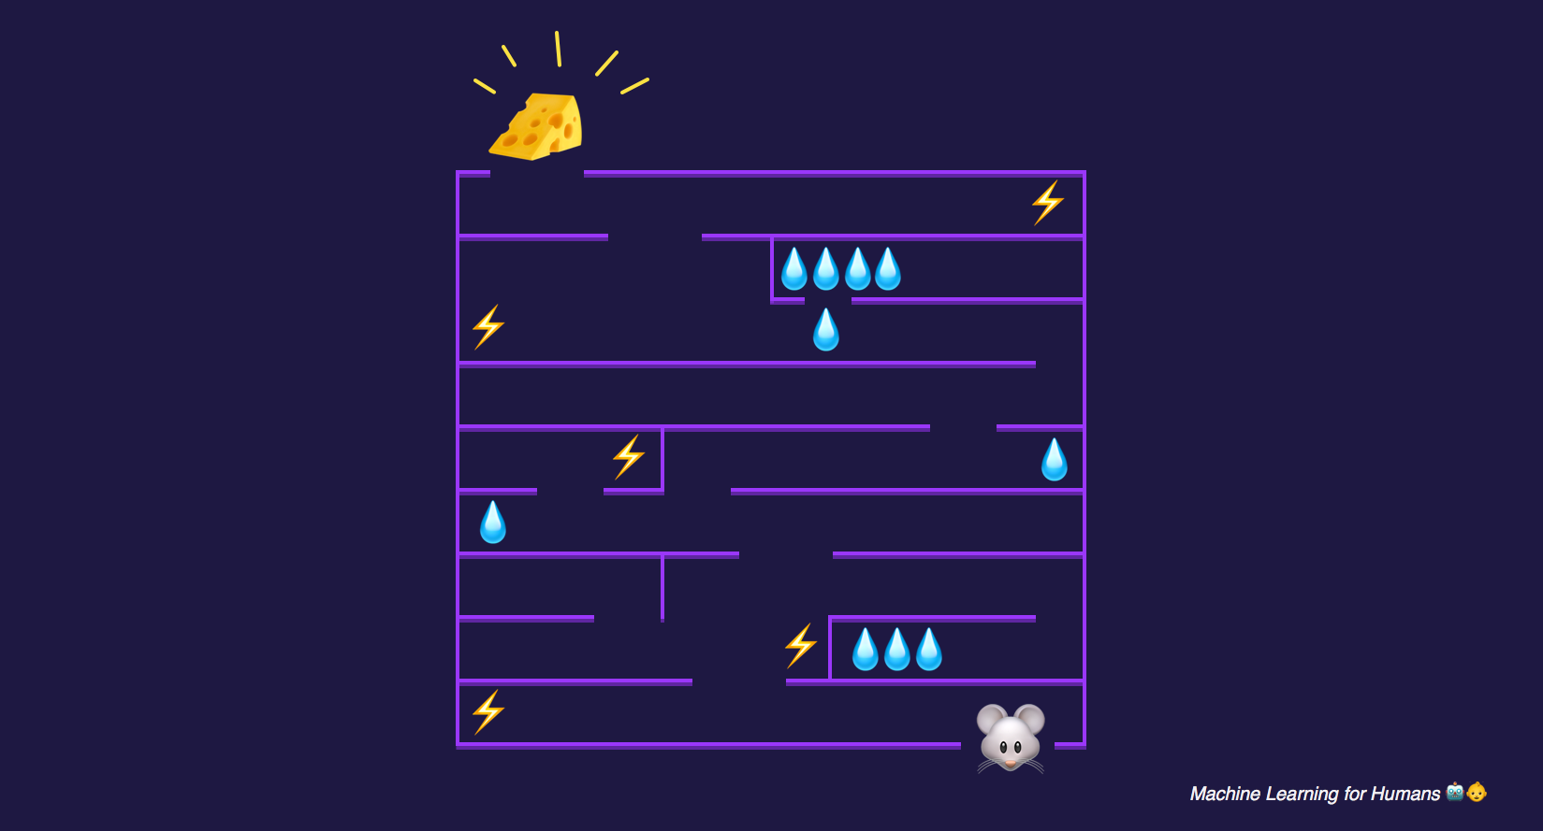
Reinforcement Learning
Example of Reinforcement Learning

Slide 31
Reinforcement Learning
AlphaGo used RL to defeat the best human Go player.
RL is an effective tool for personalized online marketing. It considers the demographic details and browsing history of the user real-time to show most relevant advertisements.

Slide 32

Reinforcement Learning
Reinforcement learning algorithms are widely used in the gaming industries to build games. It is also used to train robots to do human tasks.

Slide 33
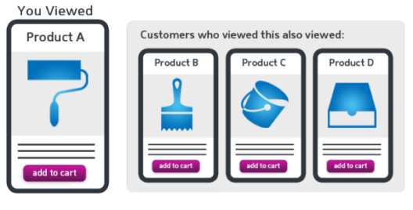
Machine Learning Applications
Traffic Alerts - Google Maps
Social Media - Automatic Friend Tagging Suggestions in Facebook (face detection and Image recognition)
Transportation and Commuting – Uber & Ola
Products Recommendations - 35% of Amazon’s revenue is generated by Product Recommendations.

Slide 34
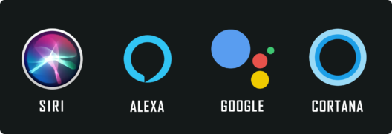
Machine Learning Applications
Virtual Personal Assistants – (Speech Recognition, Speech to Text Conversion, Natural Language Processing, Text to Speech Conversion)
Self Driving Cars - Tesla
Dynamic Pricing
Google Translate
Online Video Streaming
Fraud Detection

Slide 35
Detailed Machine Learning Process
Step 1
Step 2
Input
Data
Preparing to Model
Learning
Refined
Data
Performance Improvement
Performance Evaluation
Step 4
Step 3

Slide 36
Machine Learning Steps
Collecting Data
Preparing the Data
Choosing a Model
Training the Model
Evaluating the Model
Parameter Tuning
Making Predictions
Preparing to Model
Learning
Performance Evaluation
Performance Improvement

Slide 37
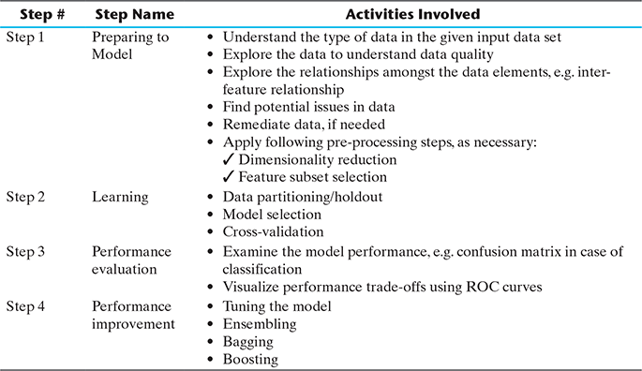
Machine Learning Activities
Activities in ML

Slide 38
Preparing to Model
The following are the preparation activities done once the input data comes into the ML system:
Understand the type of data
Explore the data to understand data quality
Explore the relationships amongst the data
Find potential issues in data
Remediate data, if needed
Apply following pre-processing steps
Dimensionality reduction
Feature subset selection

Slide 39
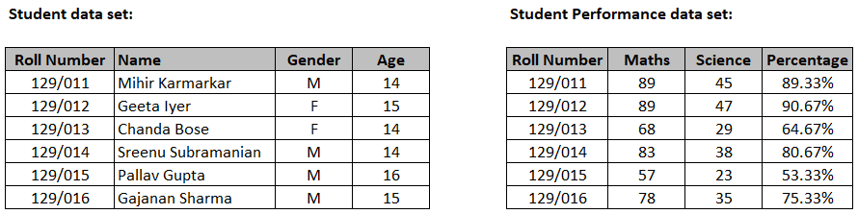
BASIC TYPES OF DATA IN MACHINE LEARNING
A dataset is a collection of related information or records
Each row of a dataset is called a record
Each dataset also has multiple attributes also termed as feature, variable, dimension
Example datasets on students

Slide 40
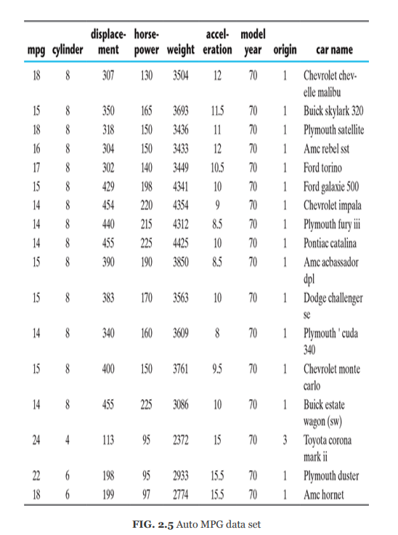

Slide 41
BASIC TYPES OF DATA
Data types can be categorized broadly into two types
Qualitative data (also called Categorical data) – Information which can’t be measured
Nominal data is one which has no numeric value– Nationality, Blood group, Gender...
Ordinal data can be arranged in a sequence – Grade, Satisfaction level
Quantitative data (also called Numeric data) – Information which can be measured
Interval data is numeric data for which not only the order is known, but the exact difference between values is also known. Eg:Body temperature
Ratio data is numeric data for which exact value can be measured. Eg: Age, Weight

Slide 42
Exploring structure of data
Standard dataset may have the data dictionary, which is a metadata repository
With the understanding of the data set attributes, we can start exploring the numeric and categorical attributes separately
Exploring numerical data – use box plot and histogram
Understand the central tendency –
Mean
Median
Mode
Understand data spread
Standard Deviation
Understand data value position

Slide 43
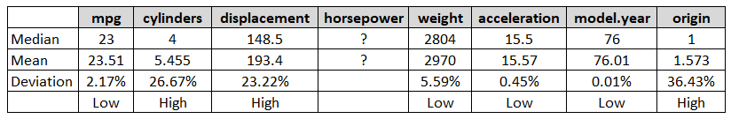
Data Exploration – central tendency
Mean vs. Median for Auto MPG

Slide 44
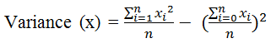
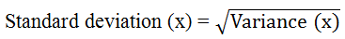
Data Exploration – Data spread
Consider the data values of two attributes
Attribute 1 values – 44, 46, 48, 45 and 47
Attribute 2 values – 34, 46, 59, 39 and 52
Both the set of values have a mean and median of 46.
First set of values is more concentrated or clustered around the mean / median value

Slide 45
Data Exploration – data value position
Any data set attribute has five values
Minimum
First quartile (Q1)
Median (Q2)
Third quartile (Q3), and
Maximum
Minimum
Q1
Q3
Maximum
Median (Q2)

Slide 46
Plotting and exploring numerical data
Box plot is an effective mechanism to get one-shot view and understand the nature of the data
Histogram is an effective visualization plot, which helps in understanding the distribution of numeric data into series of intervals, also termed as ‘bins’

Slide 47
Data Exploration – Box plot

Slide 48
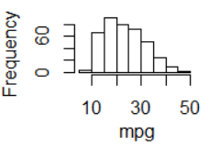
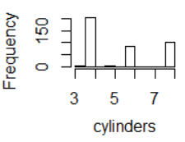
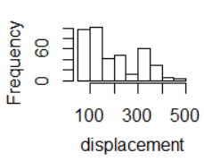
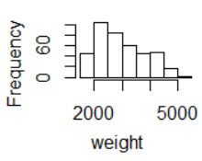
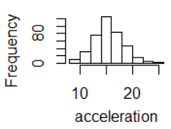
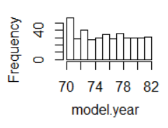
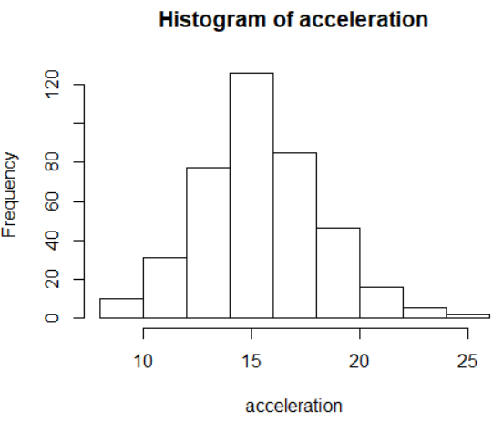
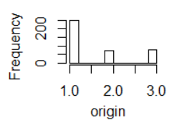
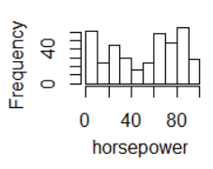
Data Exploration – Histogram
Histogram of mpg
Histogram of cylinders
Histogram of displacement
Histogram of weight
Histogram of acceleration
Histogram of model.year
Histogram of origin
Histogram of horsepower

Slide 49
Exploring relationship between variables
Scatter plot – shows the relationship between two variables
Two-way cross-tabulations(cross-tabs) are used to understand the relationship of two categorical attributes in concise way
It has a matrix format that represents a summarized view of the bi-variate frequency distribution

Slide 50
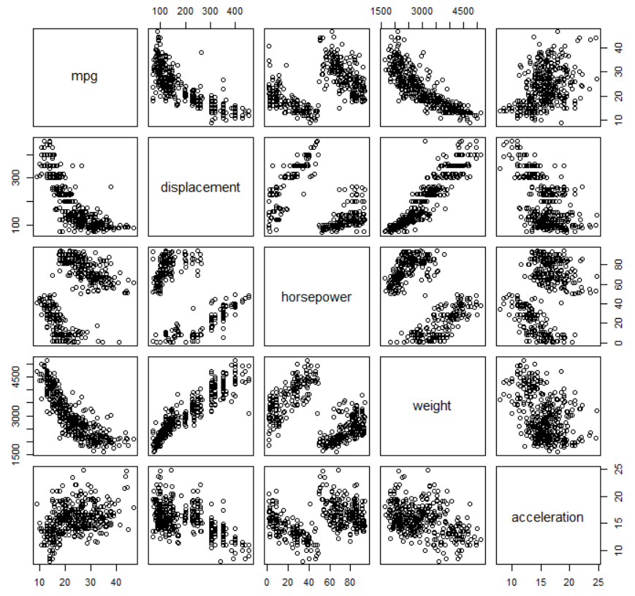
Data Exploration – Scatter plot

Slide 51
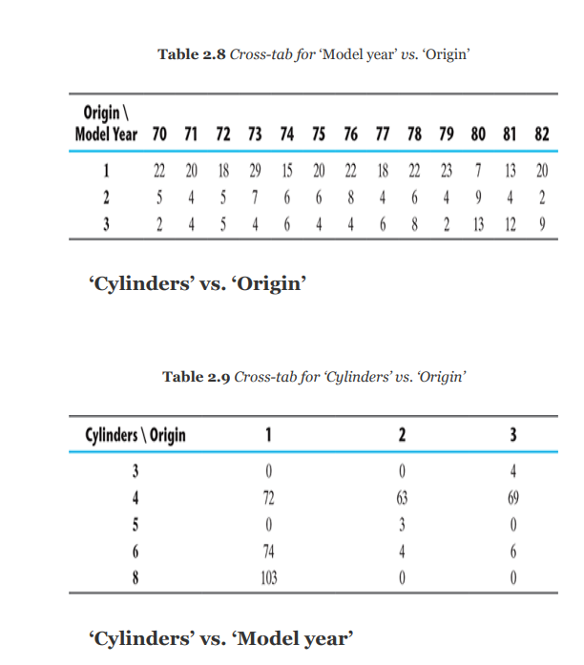
Data Exploration – Cross-tabs

Slide 52
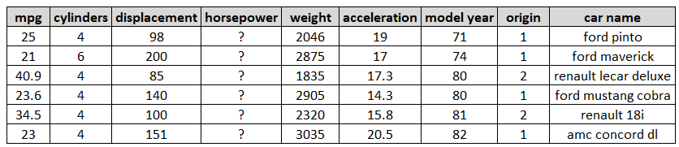
Data Quality
Most occurring data quality issues are:
Missing values
Outliers
Missing values of attribute “horsepower” in Auto MPG

Slide 53
Remediate data issues
Remove missing values / outliers – If number of records are not many, remove them.
Imputation – Impute(represent) the value with mean or median or mode
Capping - In this technique, we cap our outliers data and make the limit i.e, above a particular value or less than that value, all the values will be considered as outliers, and the number of outliers in the dataset gives that capping number.
Estimate missing values – Assign attribute values of similar data points in place of the missing value

Slide 54
Other Pre-processing Steps
Dimensionality reduction
Principal component analysis (PCA)
Singular Value Decomposition (SVD)
Linear Discriminant Analysis (LDA)
Feature subset selection achieved by
Removing irrelevant features
Selecting a subset of potentially redundant features

Slide 55
Modeling and Evaluation

Slide 56
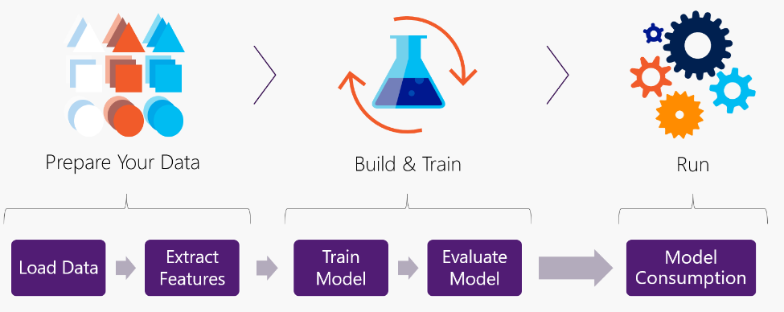
ML Process

Slide 57
Basic learning process can be divided into three parts:
1. Data Input
2. Abstraction – gives the summarized and structured
format, such that meaningful insight is obtained from
data
3. Generalization
This structured representation of raw input data to the meaningful pattern is called a model.
The process of assigning a model, and fitting a specific model to a data set is called model training.

Slide 58
What is modeling in context of machine learning?
Modelling is the process of selecting and applying an algorithm for solving a machine learning problem.
A machine learning algorithm creates its cognitive capability by building a mathematical formulation or function, known as target function, based on the features in the input data set.

Slide 59
Selecting a Model

Slide 60
Starting to model
Collect data
Explore and preparing data
Select a model
Train the model on the data
Evaluate model performance
Improve model performance

Slide 61
What are the different ML algorithms?
Supervised
Classification – KNN, Naive Bayes, Decision Tree, etc.
Regression – Simple Linear Regression, Logistic Regression
Unsupervised
Clustering – K-Means
Association Analysis
Reinforcement Learning

Slide 62
Starting to model
Multiple factors play a role to select the model for solving a machine learning problem. The most important factors are
(i) The kind of problem to solve using machine learning
(ii) The nature of the underlying data.

Slide 63
Selecting A Model
Machine learning algorithms are broadly of two types:
Models for supervised learning, which primarily focus on solving predictive problems
Models for unsupervised learning, which solve descriptive problems.

Slide 64
Selecting a model
Predictive models (supervised)
The models which are used for prediction of target features of categorical value are known as classification models.
The target feature is known as a class and the categories to which classes are divided into are called levels

Slide 65
Selecting a model
Predictive models (supervised)
Predict the value of a category or class
Problems that can be solved : Prediction of win/loss, fraudulent transactions, etc.
Examples : k-Nearest Neighbor (kNN), Naïve Bayes, Decision Tree, etc.
Predict numerical values of the target
Problems that can be solved : Prediction of revenue growth, rainfall amount, etc,
Examples: Linear Regression, Logistic Regression, etc.

Slide 66
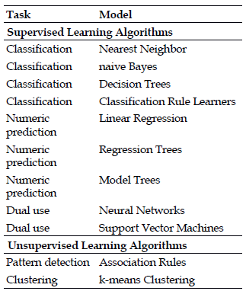
Selecting a model
Descriptive models (unsupervised) – used to describe a dataset or gain insight from a dataset
Group together similar data instances
Problems that can be solved: Customer grouping or segmentation based on social, demographic, etc. factors
Most popular model for clustering is k-Means

Slide 67


Training a Model – Holdout Method (For Supervised Learning)
70% - 80%
Training Data
Input
Data
Trained Model
Test
Data
20% - 30%
Model Performance

Slide 68
Training a Model – k-Fold Cross-Validation (For Supervised Learning)
Smaller datasets may have the challenges to divide the data of some of the classes proportionally amongst training and test datasets
A special variant of holdout method, called repeated holdout, is sometimes employed to ensure the randomness of the composed data sets.

Slide 69
Training a Model k-Fold Cross-Validation
In k-fold cross-validation technique, the data set is divided into k-completely separate random partitions called folds. It is basically repeated holdout into ‘k’ folds.
The value of ‘k’ in k-fold cross validation can be set to any number. Two extremely popular approaches are:
10-fold cross-validation (10-fold CV)
Leave-one-out cross-validation (LOOCV)

Slide 70
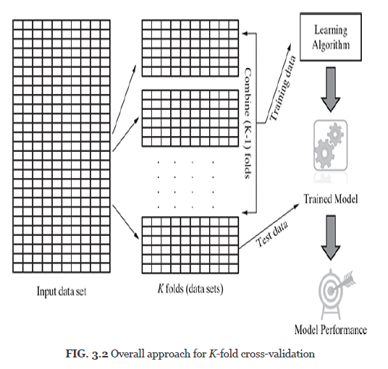
k-Fold Cross-Validation

Slide 71
Training a Model K-Fold Cross-Validation
10-fold cross-validation is by far the most popular approach. In this approach, for each of the 10-folds, each comprising of approximately 10% of the data, one of the folds is used as the test data for validating model performance trained based on the remaining 9 folds (or 90% of the data).
This is repeated 10 times, once for each of the 10 folds being used as the test data and the remaining folds as the training data. The average performance across all folds is being reported. Figure 3.3 depicts the detailed approach of selecting the ‘k’ folds in k-fold cross-validation.

Slide 72
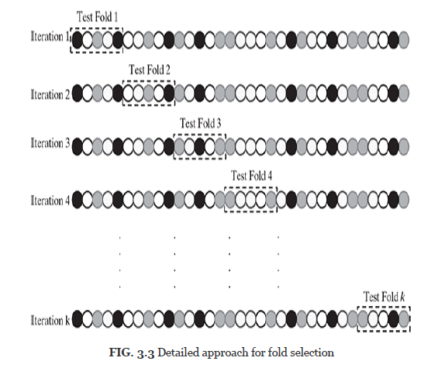
k-Fold Cross-Validation

Slide 73
Leave-one-out cross-validation
Leave-one-out cross-validation is a special case of cross-validation where the number of folds equals the number of instances in the data set. Thus, the learning algorithm is applied once for each instance, using all other instances as a training set and using the selected instance as a single-item test set.

Slide 74
Bootstrap sampling
Bootstrap sampling or simply bootstrapping is a popular way to identify training and test data sets from the input data set. It uses the technique of Simple Random Sampling with Replacement (SRSWR).
Bootstrapping randomly picks data instances from the input data set, with the possibility of the same data instance to be picked multiple times.

Slide 75
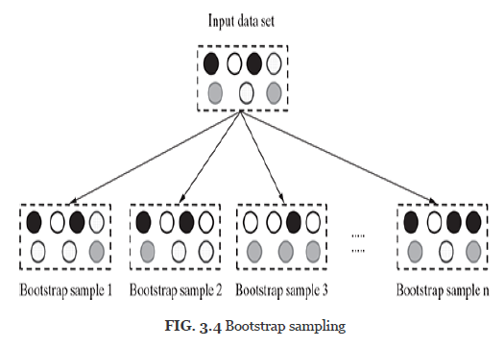
Bootstrap sampling

Slide 76
Lazy vs. Eager learning
Lazy learning (e.g., instance-based learning): Simply stores training data (or only minor processing) and waits until it is given a test tuple
Eager learning (eg. Decision trees, SVM, NN): Given a set of training set, constructs a classification model before receiving new (e.g., test) data to classify
Lazy learning : less time in training but more time in predicting Accuracy

Slide 77
Model Representation and Interpretability

Slide 78
Target function of a model is the function defining the relationship between the input (also called predictor or independent) variables and the output (also called response or dependent or target) variable.
It is represented in the general form: Y = f (X) + e, where Y is the output variable, X represents the input variables and ‘e’ is a random error term.
Fitness of a target function approximated by a learning algorithm determines how correctly it is able to classify a set of data it has never seen.

Slide 79
Model Overfitting and Underfitting
Underfitting: is a situation when your model is too simple for your data. More formally, your hypothesis about data distribution is wrong and too simple — for example, your data is quadratic and your model is linear. This situation is also called high bias.
Underfitting may occurs:
When trying to represent a non-linear data with a linear model
Due to unavailability of sufficient training data.
Underfitting results in both poor performance with training data as well as poor generalization to test data.

Slide 80
Model Overfitting and Underfitting
Overfitting is a situation when your model is too complex for your data. More formally, your hypothesis about data distribution is wrong and too complex — for example, your data is linear and your model is high-degree polynomial. This situation is also called high variance..
Overfitting, in many cases, occur as a result of trying to fit an excessively complex model to closely match the training data
Good accuracy on training data but poor on test data

Slide 81
Train a model – Under vs. Over Fit
Under fit
Balanced fit
Over fit
Under fit
Balanced fit
Over fit

Slide 82
Bias-Variance Trade-off
In supervised learning, the class value assigned by the learning model built based on the training data may differ from the actual class value.
This error in learning can be of two types –
errors due to ‘bias’
error due to ‘variance’

Slide 83
ERRORS DUE TO BIAS
Training Set 1 Training Set 2 Training Set 3 Training Set 4
Errors due to bias arise from simplifying assumptions made by the model to make the target function less complex or easier to learn.
Underfitting results in high bias

Slide 84
ERRORS DUE TO VARIANCE
Training Set 1 Training Set 2 Training Set 3 Training Set 4
Errors due to variance occur from difference in training data sets used to train the model.
Overfitting, results in high variance

Slide 85
Bias - variance trade-off
Underfitting: model is too “simple” to represent all the relevant class characteristics
High bias and low variance
High training error and high test error
Overfitting: model is too “complex” and fits irrelevant characteristics (noise) in the data
Low bias and high variance
Low training error and high test error

Slide 86
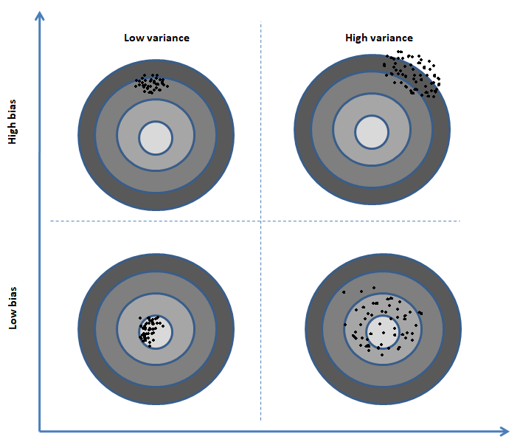
Train a model – Bias vs. Variance

Slide 87
EVALUATING PERFORMANCE OF A MODEL

Slide 88
Based on the number of correct and incorrect classifications or predictions made by a model, the accuracy of the model is calculated.
There are four possibilities with regards to the cricket match win/loss prediction:
1. The model predicted win and the team won - True Positive (TP)
2. The model predicted win and the team lost - False Positive (FP)
3. The model predicted loss and the team won - False Negative (FN)
4. The model predicted loss and the team lost - True Negative (TN)

Slide 89
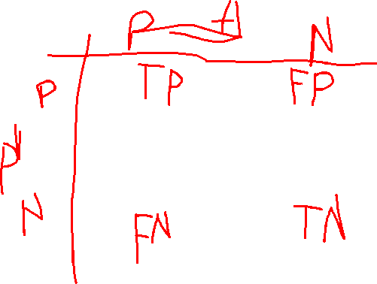

Slide 90
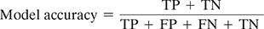
Evaluating a model (classification)
For any classification model, model accuracy is given by total number of correct classifications (either as the class of interest, i.e. True Positive or as not the class of interest, i.e. True Negative) divided by total number of classifications done.
A matrix containing correct and incorrect predictions in the form of TPs, FPs, FNs and TNs is known as confusion matrix.

Slide 91
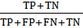
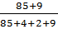
Evaluating a model (classification)
 | Actual Win | Actual Loss
Predicted Win | 85 | 4
Predicted Loss | 2 | 9
Model accuracy =
=
=
= 0.94 or 94%

Slide 92
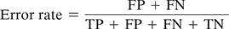
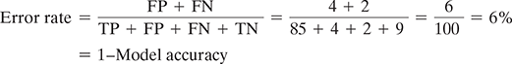
Evaluating a model (classification)
The percentage of misclassifications is indicated using error rate which is measured as
In context of the previous confusion matrix,

Slide 93
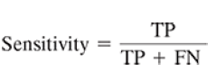
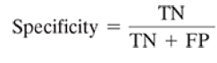
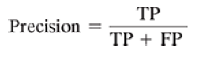
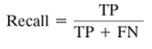

Evaluating a model (classification)
Some measures of model performance which are more important than accuracy.

Slide 94

Evaluating a model (regression)

Slide 95
Evaluating a model (clustering)
“Clustering is in the eye of the beholder”
Internal evaluation
Silhouette width
External evaluation
Purity

Slide 96

Evaluating a model (clustering)
Cluster 2
Cluster 1
a_{i2}
a_{i1}
a_{in_1}
b₁₄(1)
b₁₄(2)
b₁₄(n₄)
si·loh·et
Cluster 3
Cluster 4
Silhouette width calculation

Slide 97
Thank You

